Slide 1
Byzantine Fault Tolerant Raft
Dennis Wang, Nina Tai, Yicheng An
Notes:
Stephen: 8-12, Dennis: 1-2,13, Nina: 3-7

Slide 2
Raft Review
Consensus problem divided into 3 subproblems:
Log replication
Leader election
Safety

Slide 3
Problem Statement - Byzantine Failure
Extended fault model:
Start leader election process arbitrarily
Modify client’s request and violate correctness
Instruct different servers to commit different things
Respond arbitrary results to clients or ignore them
*Note: We assume the client is non-faulty and network is not controlled by adversary

Slide 4
RaftBFT
Raft with extensions:
Log Replication: Proof-based, more client interaction
Leader Election: Single candidate per term
Safety: Cryptographic signatures
Notes:
single candidate per term meaning that only the node with id = v mod r can become candidate of that term

Slide 5
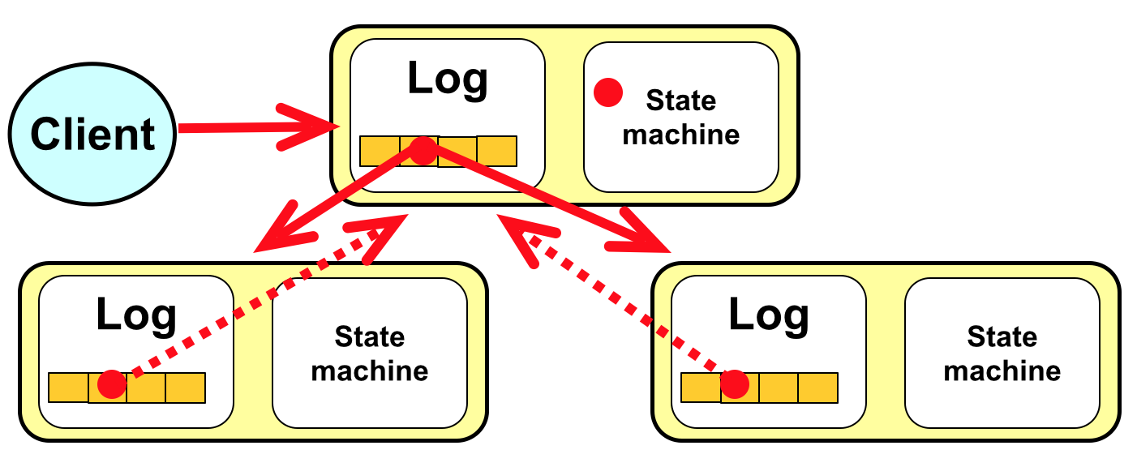
Raft - Log Replication
Leader accepts client commands.
Leader appends to own log and issues AppendEntry RPC to followers.
Once safely replicated, entry is committed and externalized.

Slide 6
RaftBFT - Log Replication
Client -> Leader: Req
Leader -> Followers: AppendEntry
Followers -> Leader: AppendEntryAck
Leader -> Followers: PrepareEntry (proof of 2f+1 AppendEntryAck’s)
Followers -> Leader: PrepareEntryAck
Leader -> Followers: CommitEntry (proof of 2f+1 PrepareEntryAck’s)
All -> Client: ReqFinished
Notes:
the key here is that we want to maintain raft’s design principle which is followers don’t talk directly with each other, just with leader

Slide 7
RaftBFT - Client Interaction
Writes go to leader
Reads go to all servers
Client waits for f+1 responses
Time out - request followers to do a leader election
Client
Client
Leader
Leader
follower
follower
follower
follower
follower
follower
Original Raft
RaftBFT

Slide 8
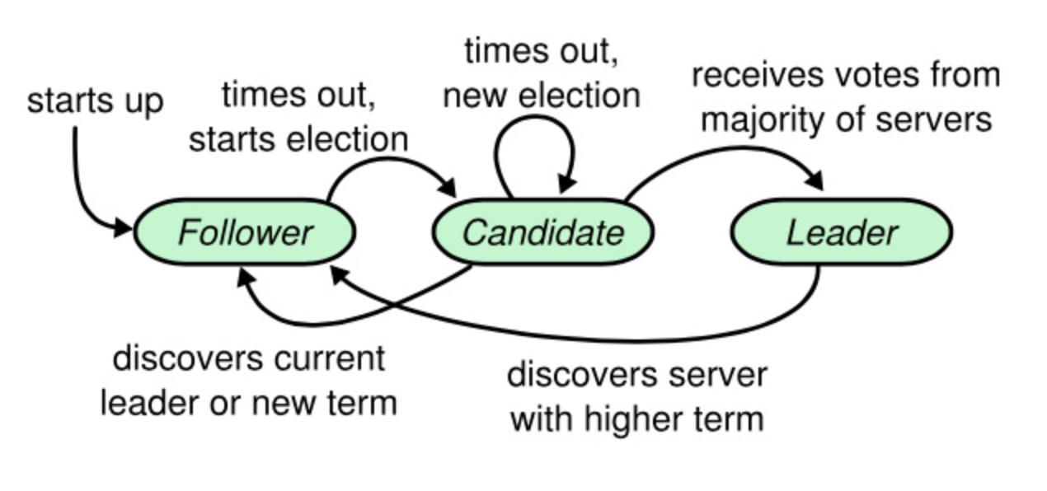
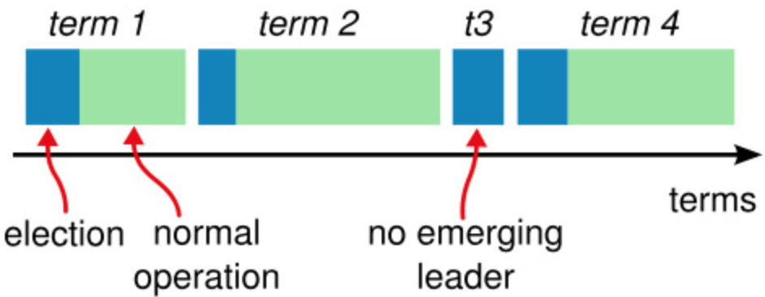
Raft - Leader Election

Slide 9
RaftBFT - Leader Election
Triggered by
Client: broadcast request to followers after timeout
Follower: timed out when waiting for heartbeats from leader
StartElection request sent to node id = newTerm % totalServers

Slide 10
RaftBFT - Leader Election (cont)
Election starts when a Follower receives 2f+1 requests and becomes Candidate
Candidate requests votes with proof of election start
Candidate with most up-to-date log can become leader, just like Raft
If there are two candidates both starting the leader election, the one with higher terms win

Slide 11
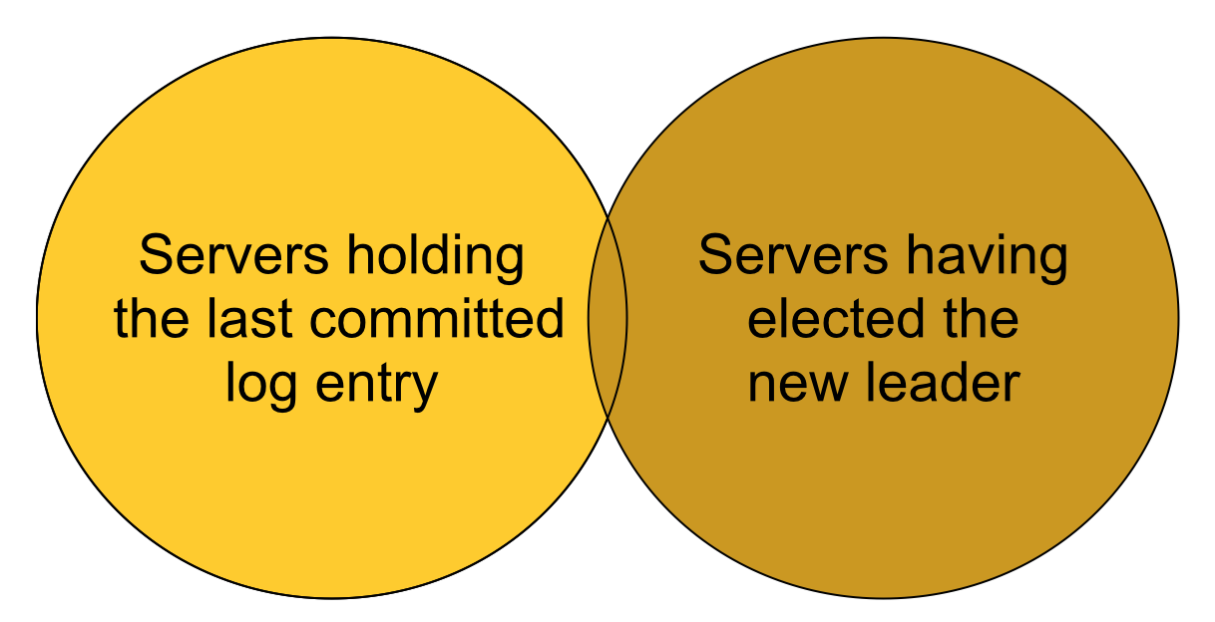
Raft - Safety
Leader Completeness: The leader for any given term contains all the entries committed in previous terms.
If a candidate’s log is at least as up-to-date as any other majority of logs, then it will hold all committed entries

Slide 12
RaftBFT - Cryptographic Signatures
Each node holds the public key for all other nodes
Every request is signed by private key of sender and verified by receiver
In addition to details of the operation, each log entry holds 2f+1 signatures as proof that it was committed at its index
This proof is sent with any append operation

Slide 13
Demo
Notes:
mention that commit phase is not implemented

Slide 14
Link to code
https://github.com/g60726/zatt

Slide 15
Thanks! Questions?

